Slide 1

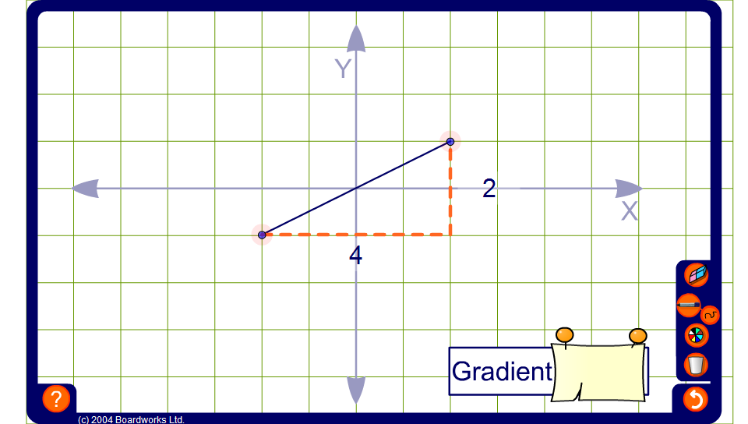


Exploring gradients
Notes:
Drag the end points of the line to demonstrate lines of varying gradient. (Notice that the gradient of a vertical line will appear as ‘undefined’ and the gradient of a horizontal line as 0).
Show that the steeper the line is the larger the gradient.
We can find the gradient by asking,
For every unit we move horizontally (from left to right) how many squares do we move vertically (from bottom to top)?
Demonstrate to pupils that when the line slopes downwards the change in the vertical distance is negative and so the gradient is negative.
Define the gradient as ‘the vertical distance between the end points (from bottom to top) over the horizontal distance between the end points (from left to right) ‘.
Show how the length of the line can be changed without changing the gradient by using equivalent fractions. For example, if the vertical distance between the end points is 6 and the horizontal distance between the end points is 4, the gradient of the line is ³/₂. If we change the vertical distance to 9 and the horizontal distance to 6, the gradient of the line is still ³/₂. Point out that it is most useful to write gradients as vulgar fractions. For example, the gradient ³/₂ tells us that for every 2 squares we move along we move 3 up.
Hide the value of the gradient and ask pupils to tell you the gradients of given lines. Include gradients that need to be cancelled down and negative gradients.
Ask volunteers to come to the board and drag the end points of the line to give required gradients.
For example, if you ask the volunteer to make a line with a gradient of –2 they could have the horizontal distance between the end points as 5 and the vertical distance between the end points as –10. Challenge another pupil to make the line longer (or shorter) without changing the gradient.
Ask pupils to give you the coordinates of any two points on the line. Establish that the gradient can by found by dividing the difference between the y-coordinates by the difference between the x-coordinates.

